Slide 1
Chicago Crime Data
Group 6 | Nirmiti Patil | Ayush Dodal | Kalind Joshi

Slide 2
Index
Introduction
Dataset Description
Data Profiling & Pre-processing
Neo4j Graph Database
Visualization
Value Generated from dashboard
Velero ETP
Challenges Encountered
Conclusion

Slide 3
Introduction
In Chicago, crime has been tracked by the Chicago Police Department's Bureau of Records since the beginning of the 20th century.
The city's overall crime rate, especially the violent crime rate, is higher than the US average.
Chicago was responsible for nearly half of 2016's increase in homicides in the US, though the nation's crime rates remained near historic lows as of 2016.
Some attribute the city's strong gang culture to the city's unusually high crime rate compared to neighboring cities, and some do not.
The city has faced challenges with violent crime, particularly in certain neighborhoods, including homicides, shootings, and robberies.
Property crimes such as theft, burglary, and motor vehicle theft have also been reported in various parts of the city.

Slide 4
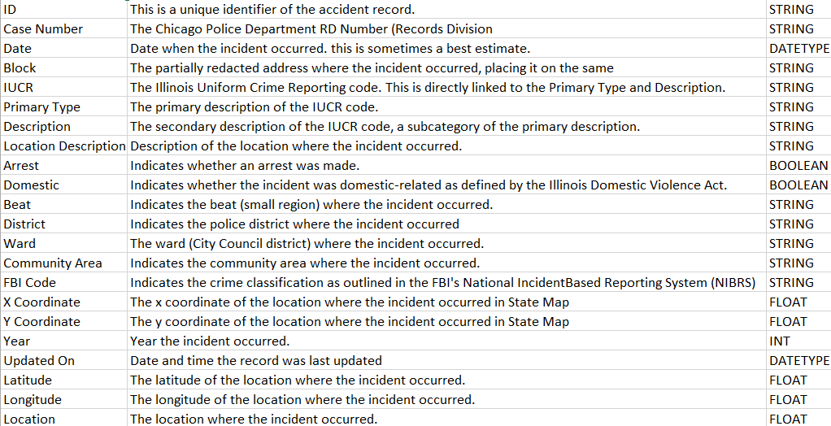
Dataset Description
Our dataset, titled 'Chicago Crime', contains approximately 7 million rows of data. This dataset includes information such as the FBI and IUCR codes corresponding to the crime committed, the type of crime, the location of the crime, and whether an arrest was made in connection with the crime.
There are 4 files containing a cumulative of 8 million rows.
These files are distributed in sets of 4 years, spanning from 2001 to 2023.
An in-depth analysis of these files will be done in further slides

Slide 5
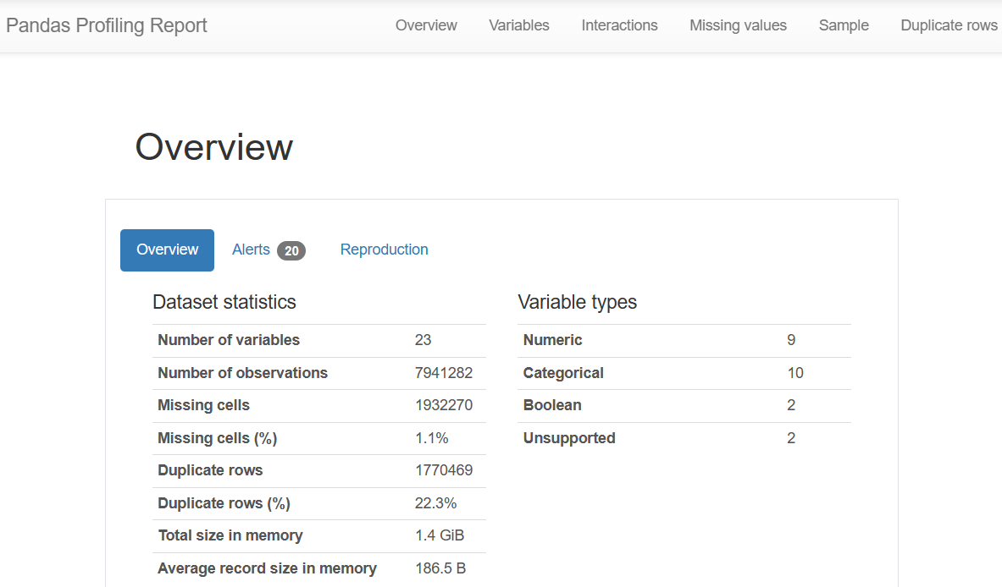
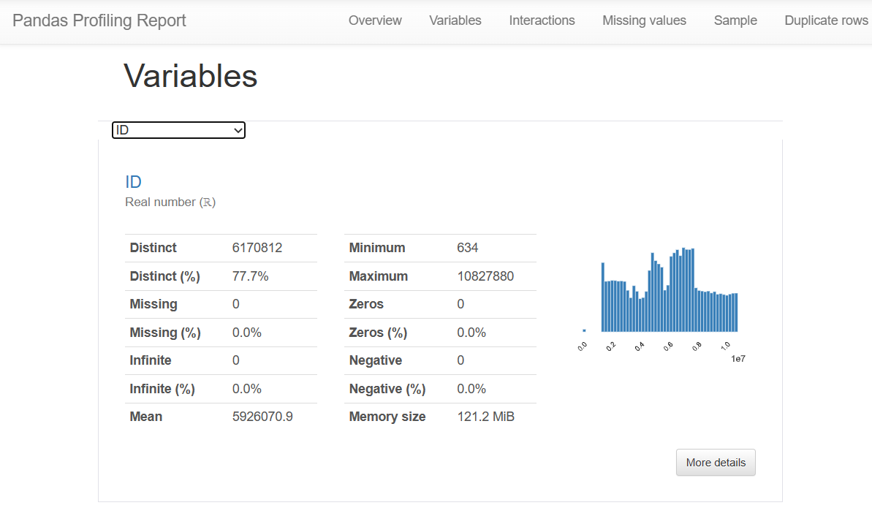
Data Profiling & Pre-processing
We studied the dataset and all the attributes it comprises of and created a profiling report that shows various insights.

Slide 6
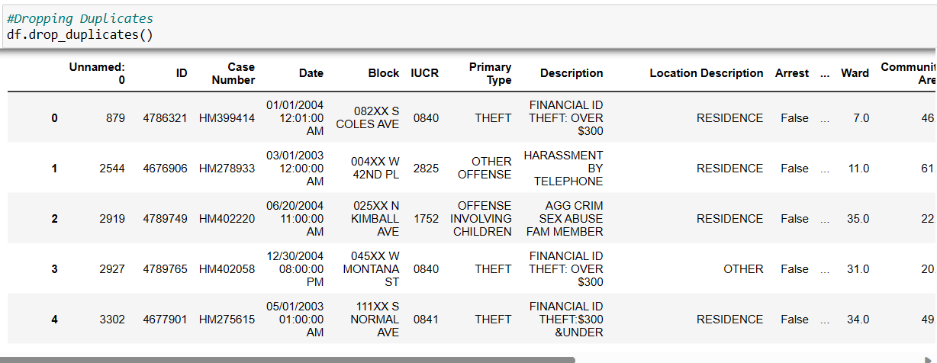
Data Profiling & Pre-processing
We dealt with the duplicate values and got rid of them as they provide inaccurate results and also increase data processing time.

Slide 7
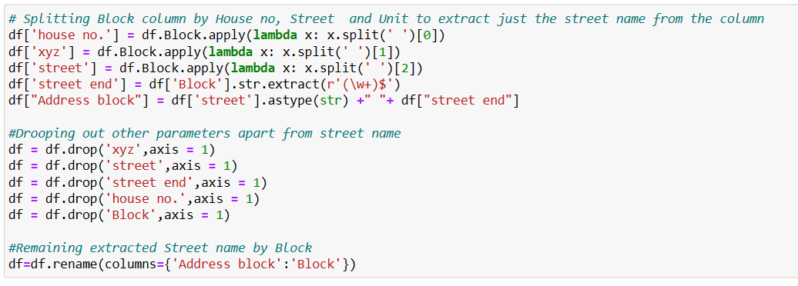
Data Profiling & Pre-processing

Slide 8
Neo4j Graph Database

Slide 9
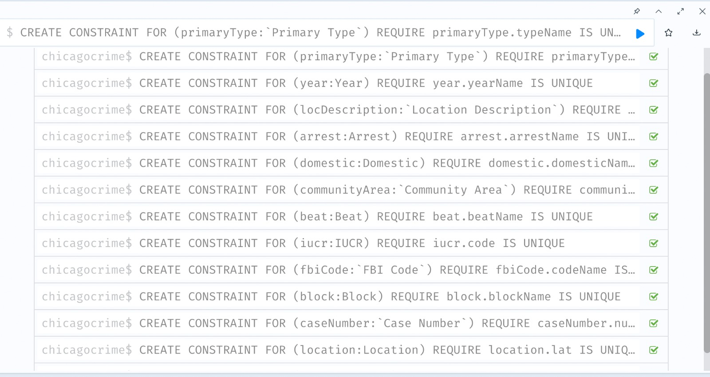
Neo4J Graph Database

Slide 10
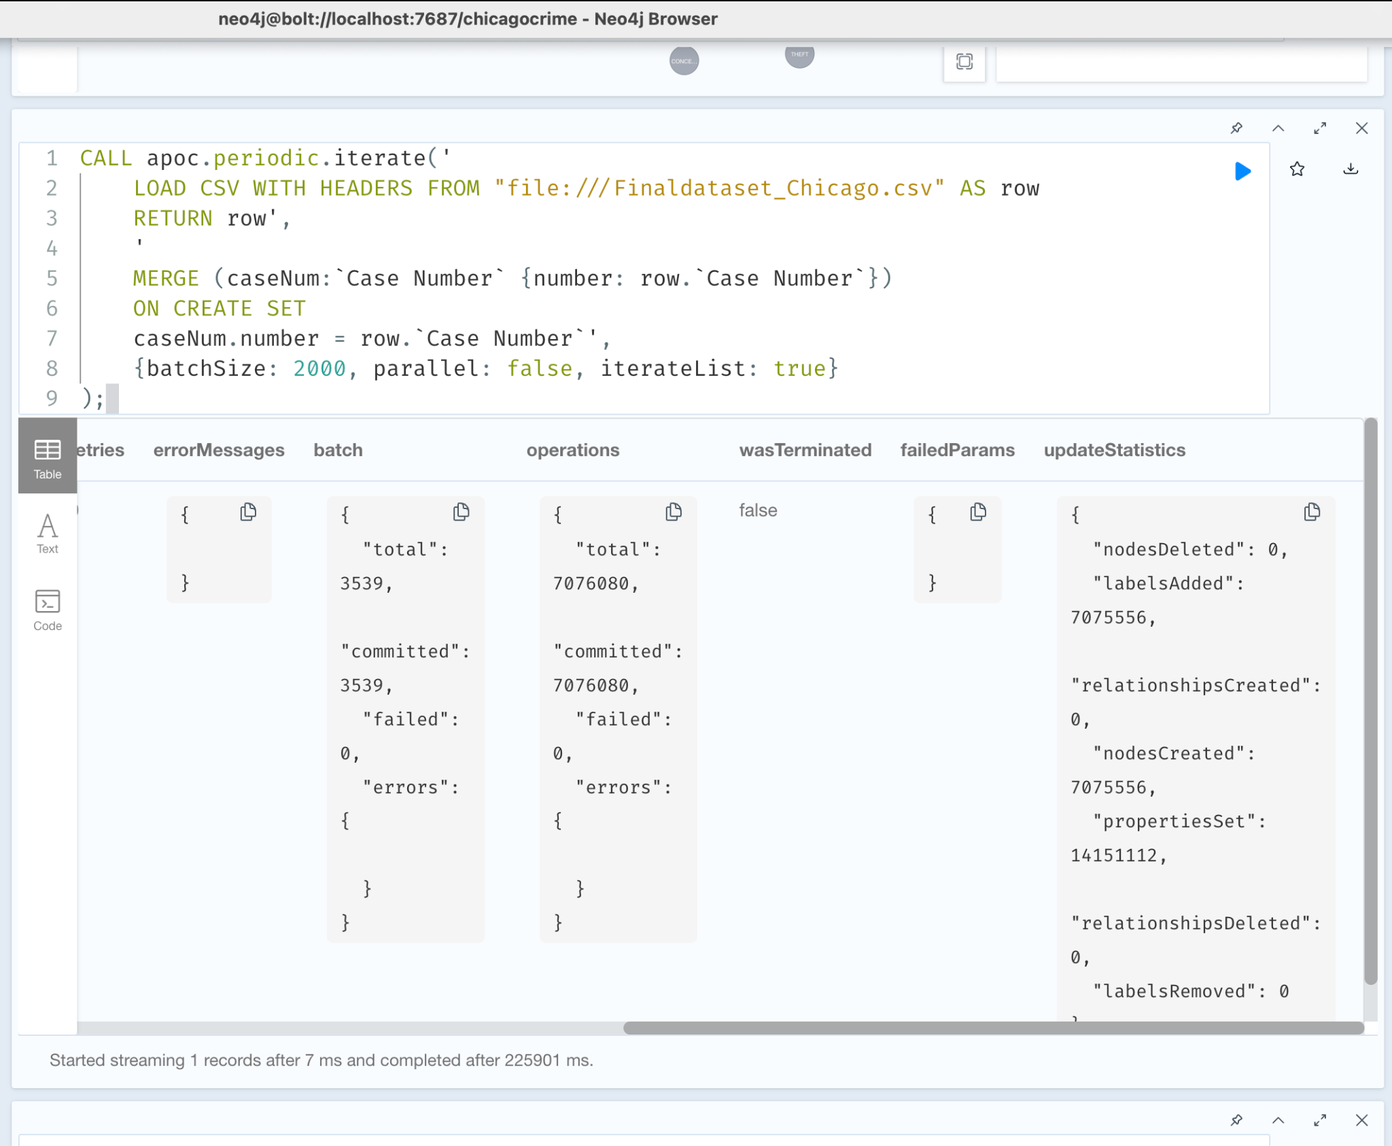
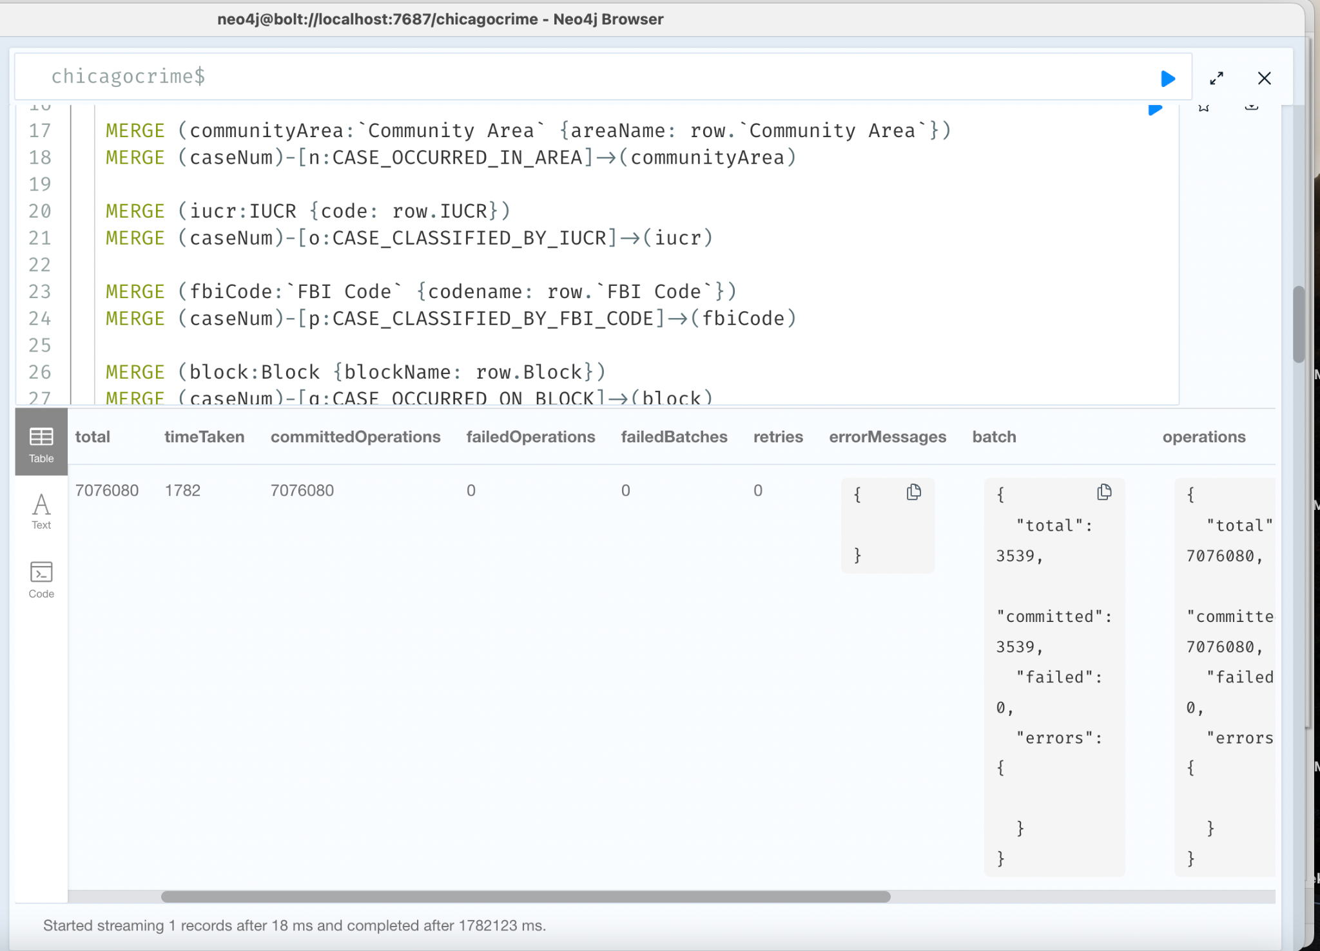
Node & Relationship Cypher Code

Slide 11
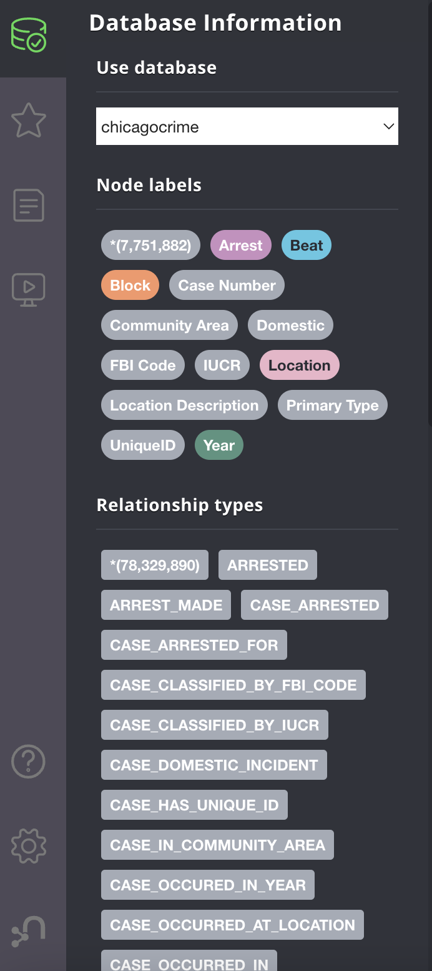
Node & Relationship
13 Nodes
23 Relationships

Slide 12
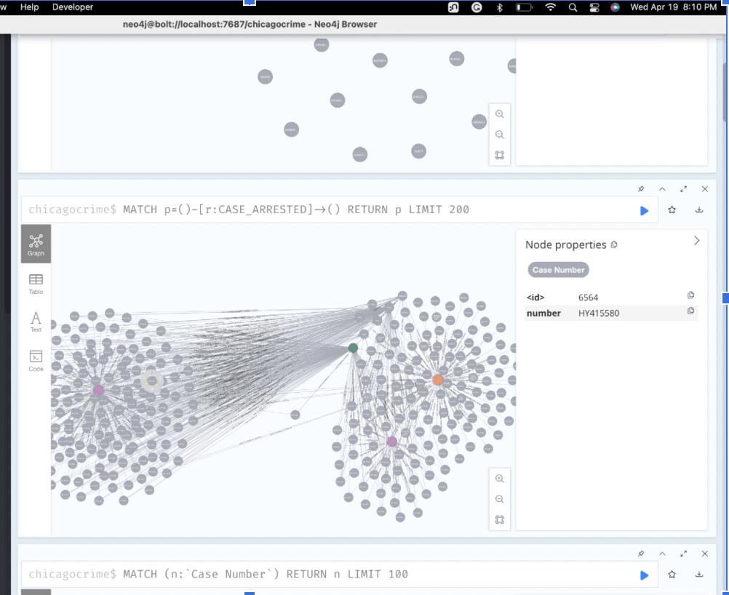
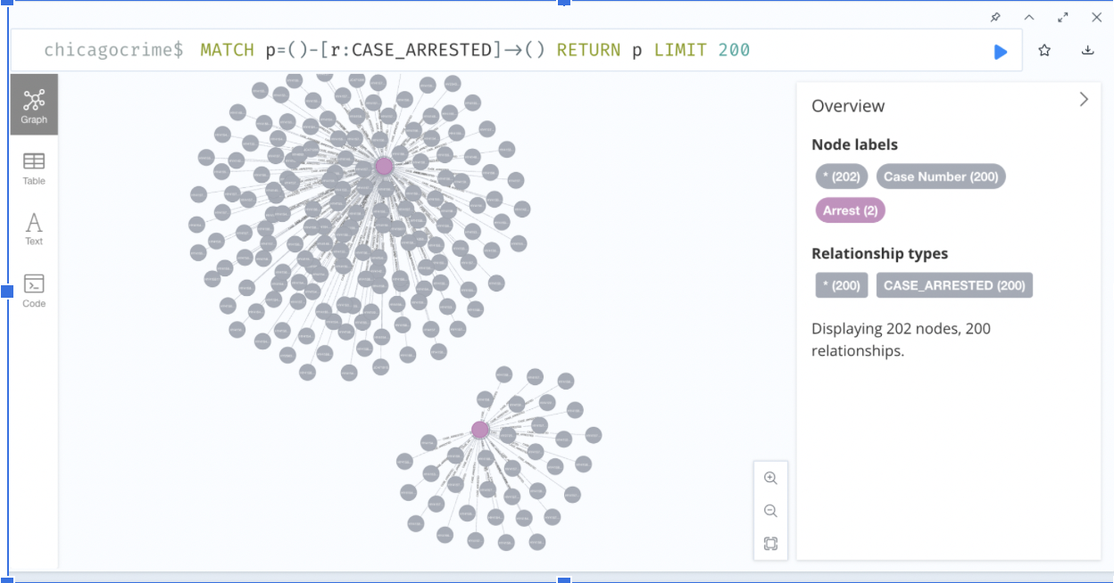
Neo4j Graph Database

Slide 13
Tableau Visualization

Slide 14
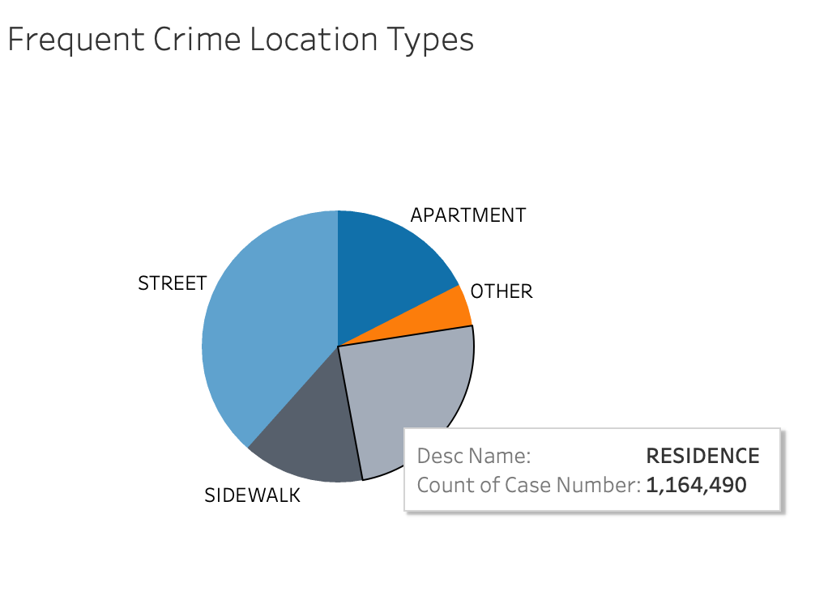
Tableau Visualization

Slide 15
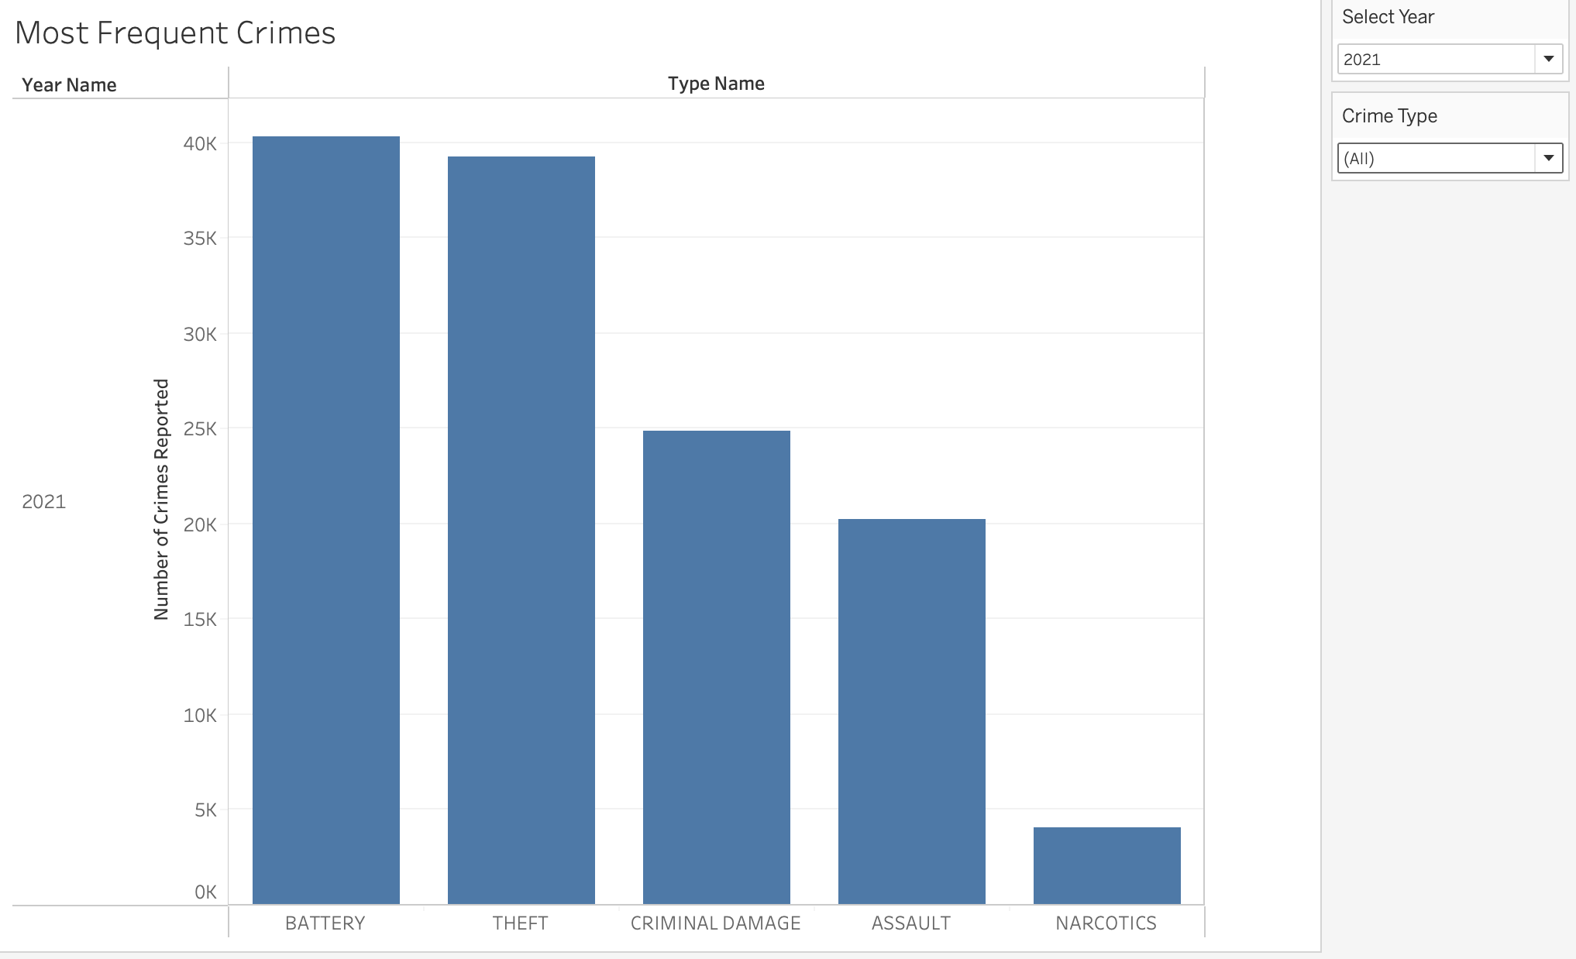
Tableau Visualization

Slide 16
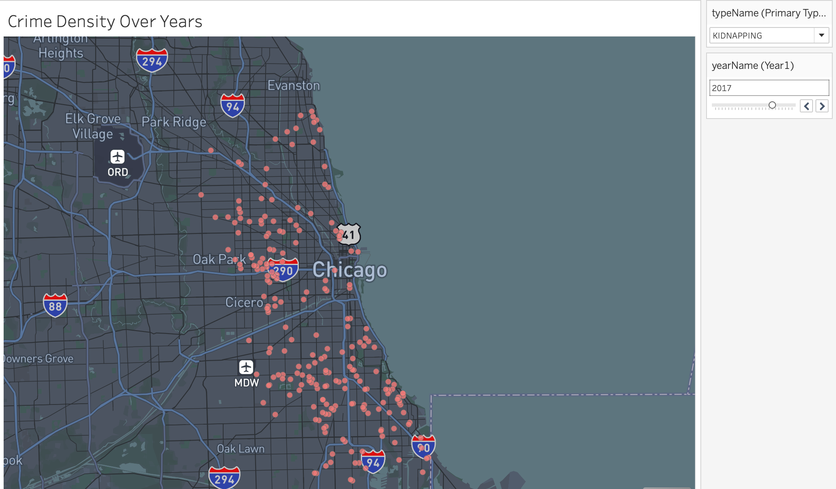
Tableau Visualization

Slide 17
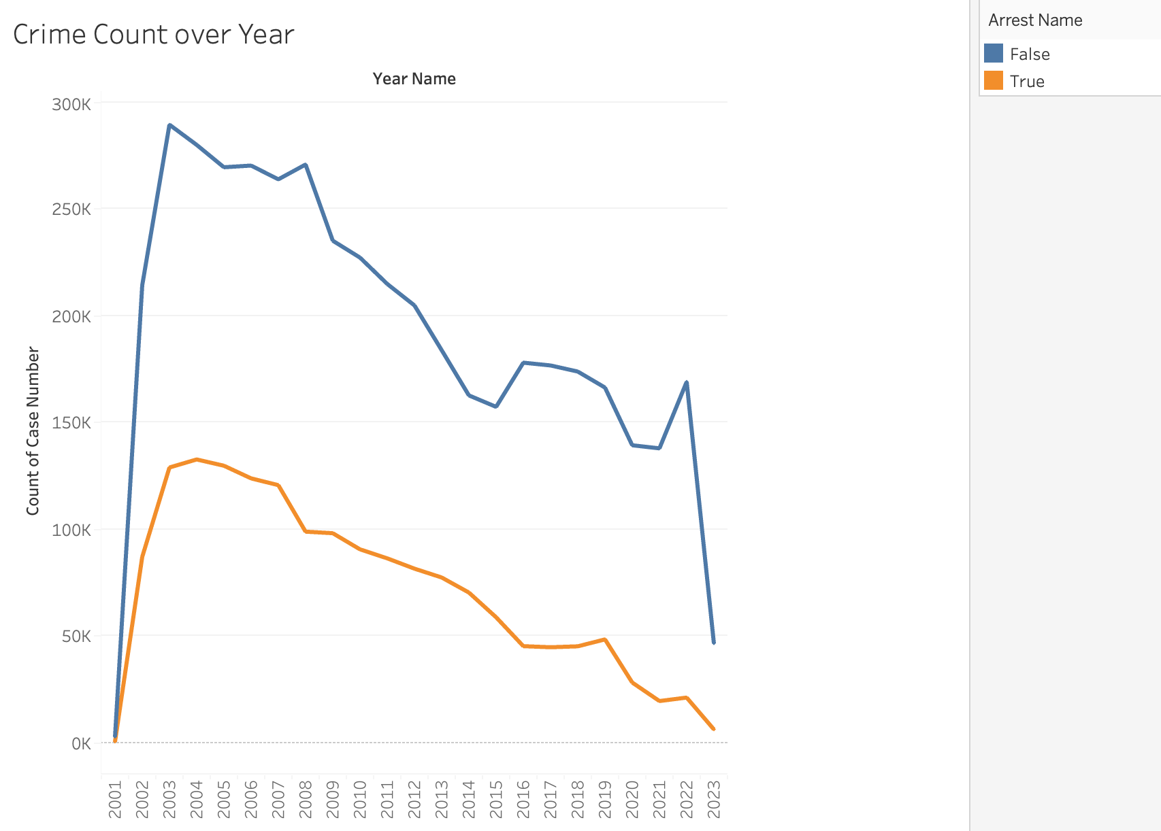
Tableau Visualization

Slide 18
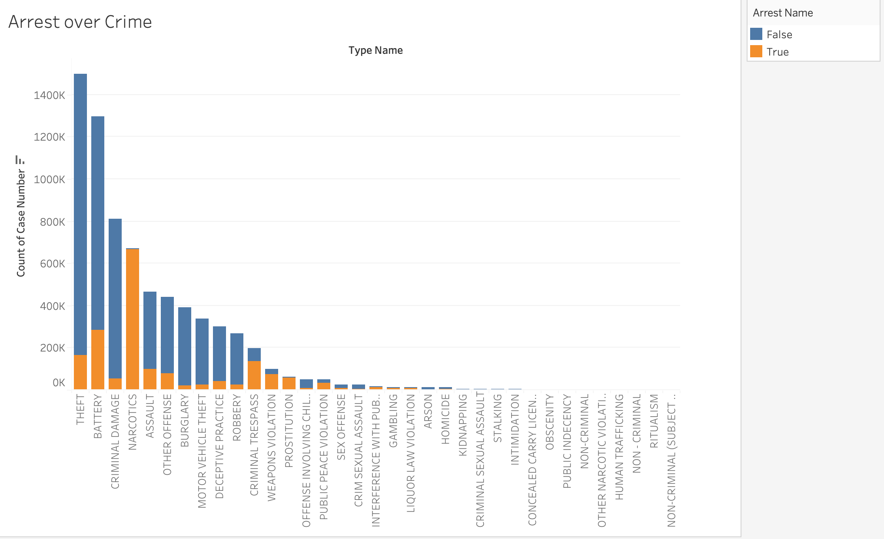
Tableau Visualization

Slide 19
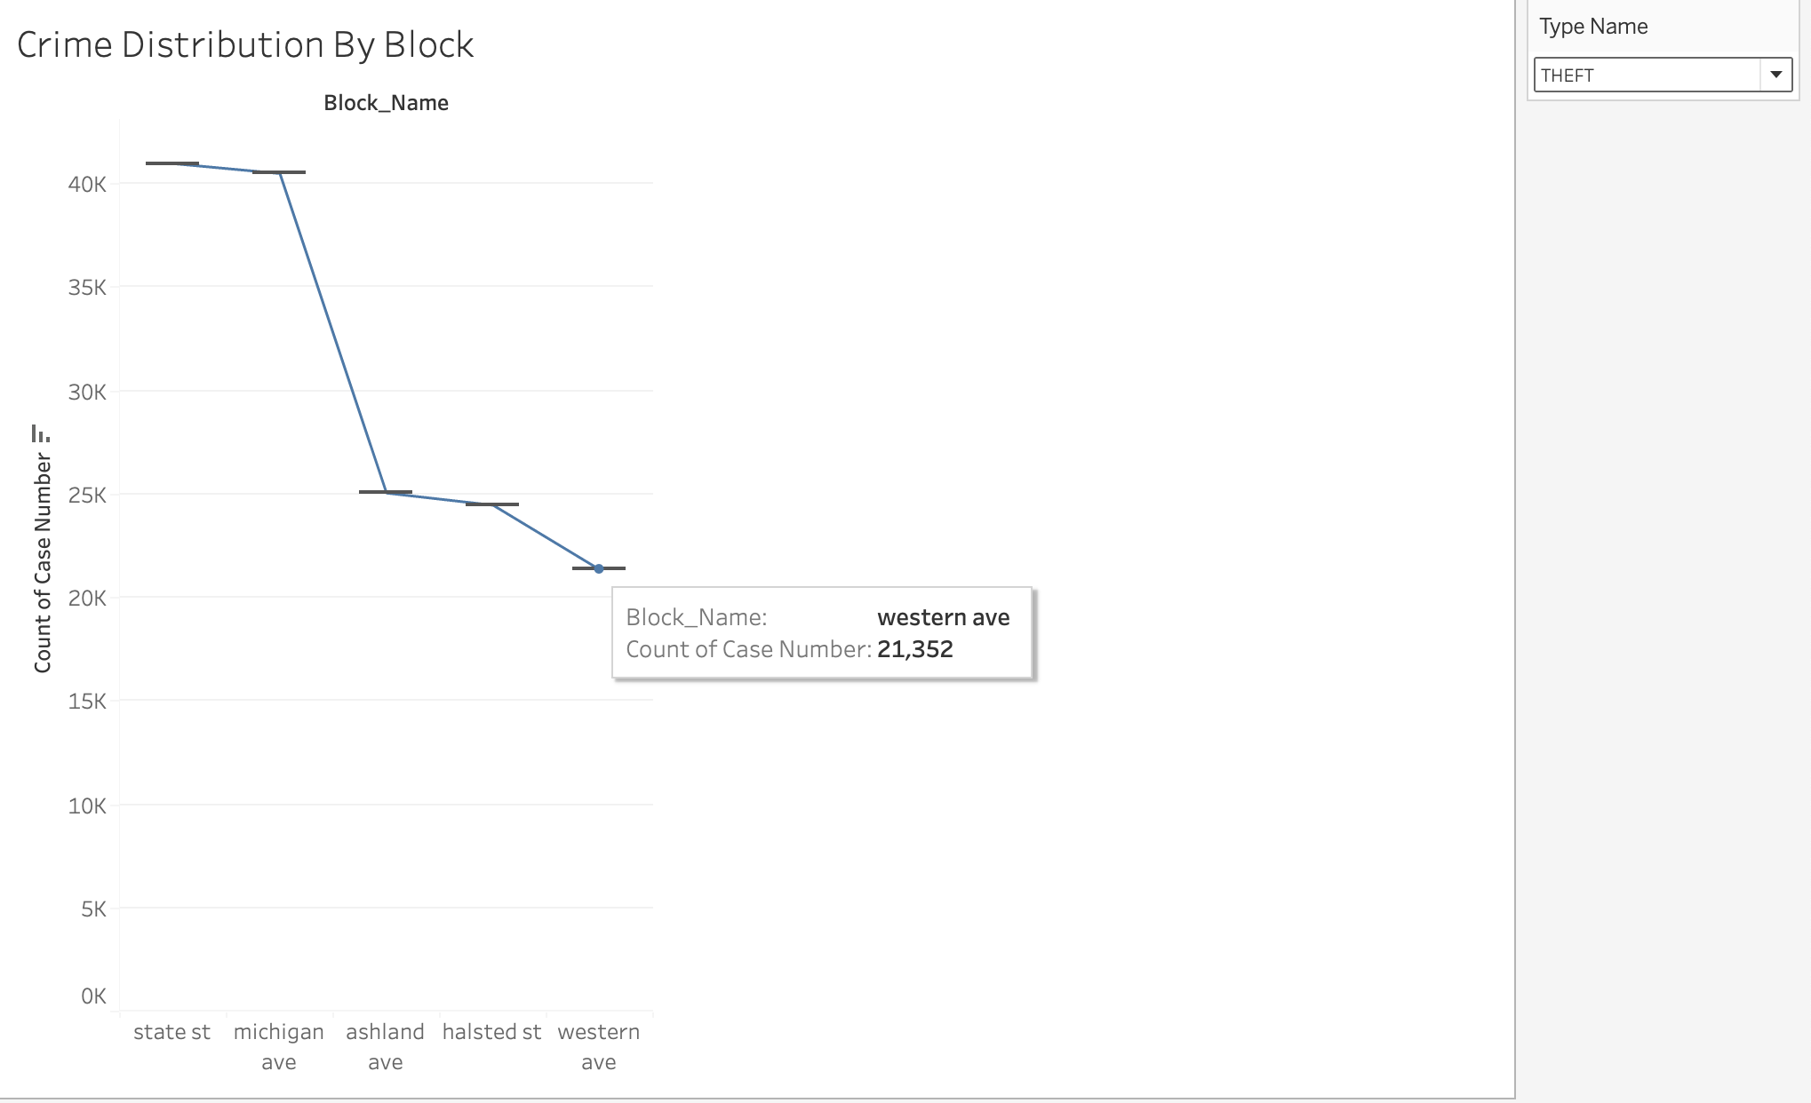
Tableau Visualization

Slide 20
Value Generated from dashboard
Who will be using this dashboard and how do they benefit from this dashboard?
The visualization dashboard on Tableau for Chicago crimes can provide valuable insights to a wide range of users, including law enforcement agencies, city officials, researchers, analysts, and the general public, to make informed decisions and take appropriate actions to address crime-related issues effectively.
What value would be generated using this dashboard?
The visualization dashboard on Tableau for Chicago crimes can generate value by providing stakeholders with data-driven insights, enhancing decision-making, enabling proactive crime prevention, optimizing resource allocation, and promoting transparency and accountability. These benefits can contribute to more effective crime management strategies, improved public safety, and stronger relationships between law enforcement agencies and communities.

Slide 21
Velero ETP

Slide 22
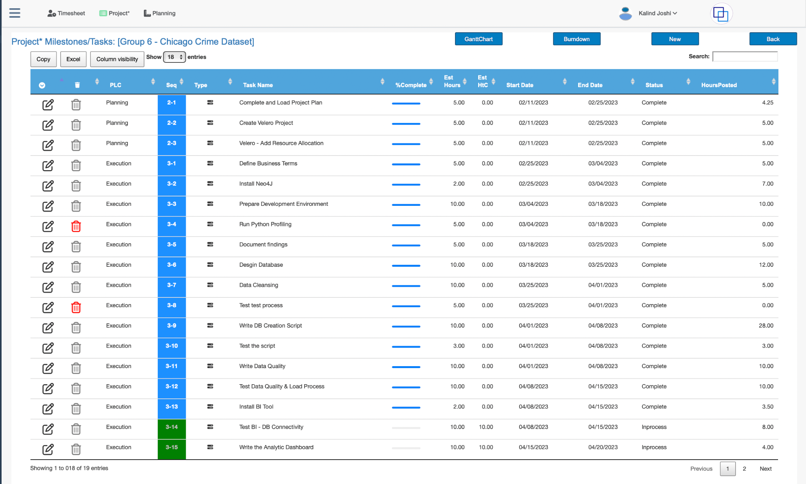
Velero ETP

Slide 23
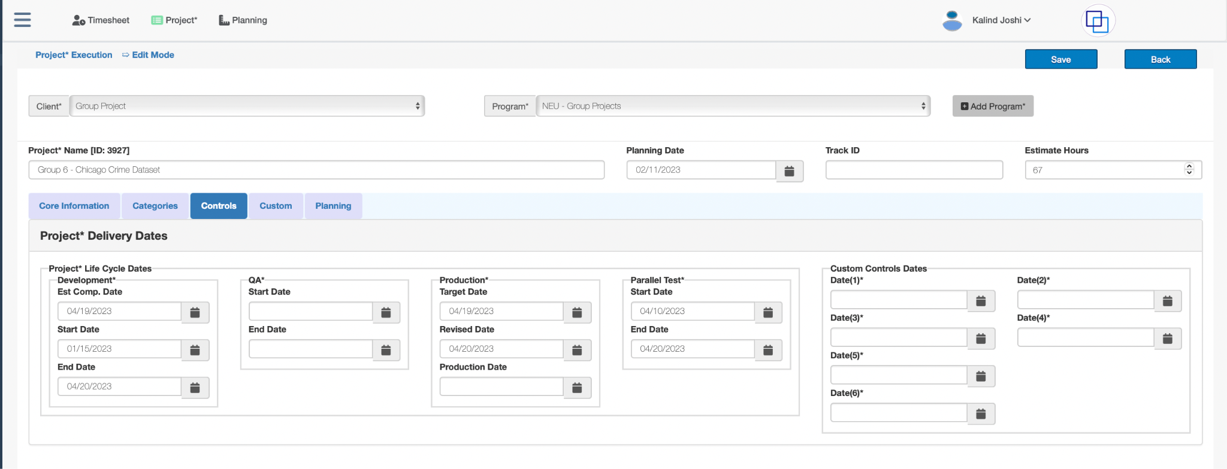
Velero ETP

Slide 24
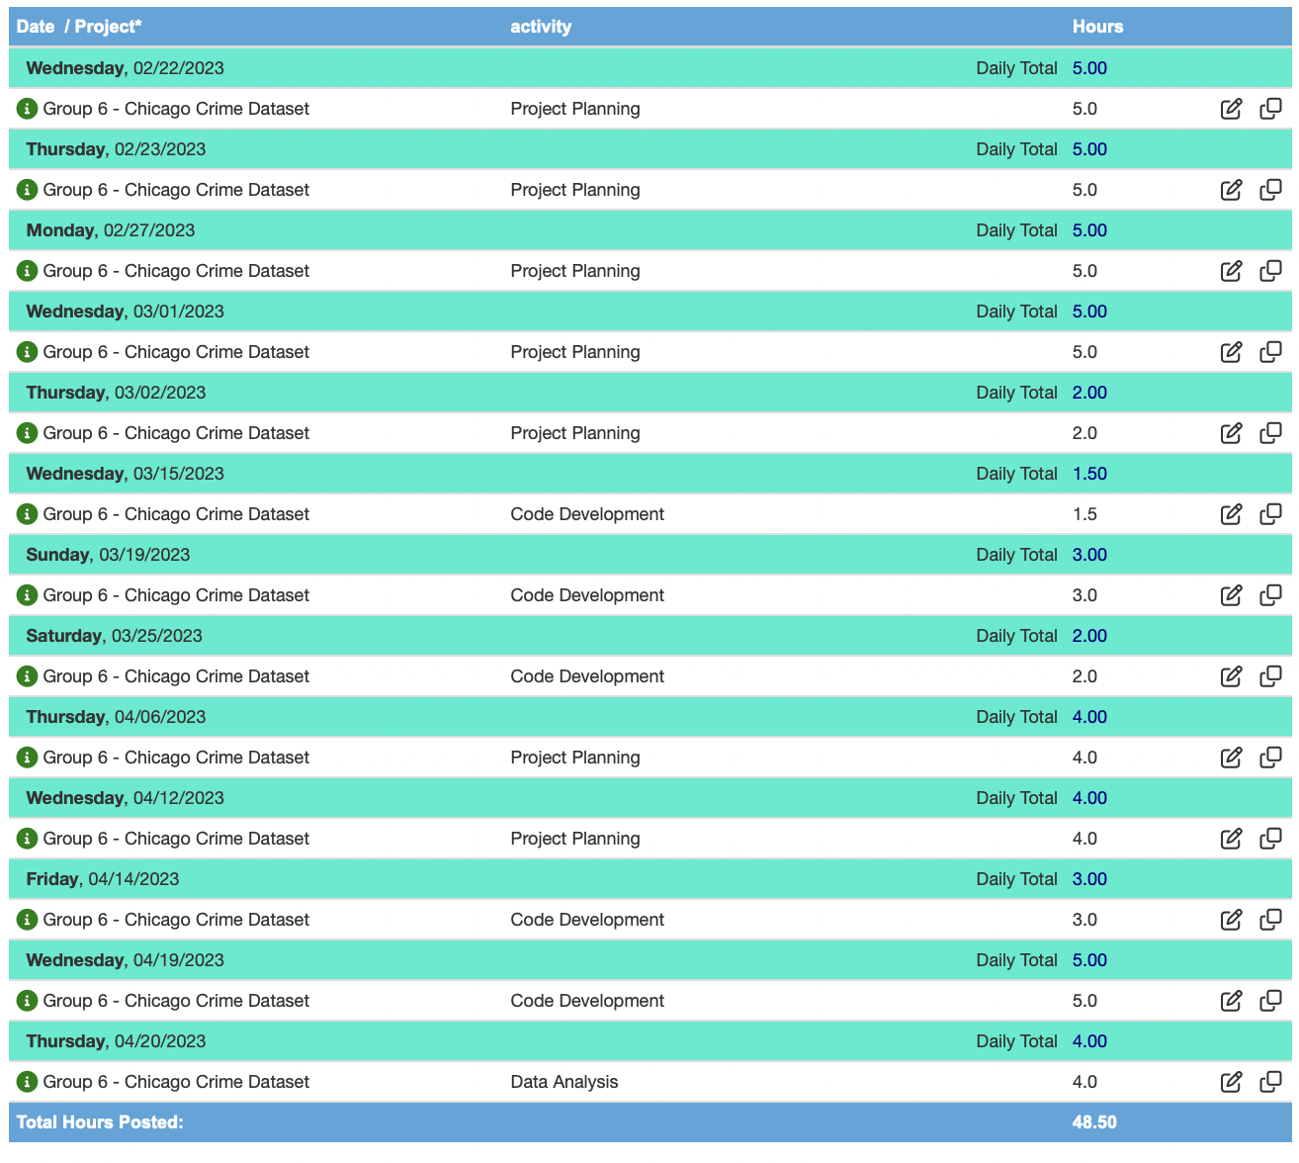
Velero ETP

Slide 25
Challenges Encountered
While working with the Chicago crime dataset, the "Location" column was encountered. This column contains values in the format of (latitude, longitude) and is not compatible with Neo4j due to the long floating values, which occupy a lot of time. As a result, the query gets terminated.
The "Case Number" column in the Chicago crime dataset contained 7 million rows, which were too large to process and resulted in memory errors when trying to load them into Neo4j. This posed a significant challenge as the data in this column was crucial for creating relationships between nodes.

Slide 26
Conclusion
In conclusion, we have completed the necessary data cleaning and preprocessing tasks on the provided dataset.
We have also successfully downloaded and installed Neo4j and Tableau, and established a connection between them using the JDBC connector.
This has enabled us to create visualizations from the dataset, which are valuable for researchers, law enforcement agencies, the general public, and city officials.
These visualizations provide insights and trends related to crime types, locations of incidents, and changes over time, allowing for a better understanding of crime patterns and dynamics in the given context.

Slide 27
Thank You !

